Slide 1
Bar Crawl
Matt Dubow
Capstone Project 2

Slide 2
Intro
Overview: Using phone accelerometer data, a machine learning model can predict whether an individual is drunk based on the variance in their movement.
Client: Public health organizations, sociologists, universities, younger people. Potential to create app that warns users of heavy alcohol use.
Data: UCI Detecting Heavy Drinking Dataset https://archive.ics.uci.edu/ml/datasets/Bar+Crawl%3A+Detecting+Heavy+Drinking
Data Description: Accelerometer data for 13 participants involved in a “bar crawl” event. CSV file includes position in 3 axes and time of measurement in milliseconds. Additionally, separate CSV files for each participant of TAC (transdermal alcohol content) readings, taken roughly every half hour. “Clean” readings are shifted back in time by 45 minutes to account for time it takes to release alcohol through the skin.
Features: variance in 3 axes (continuous numerical), participant ID (categorical string), phone type (categorical string)
Target: "drunk" label (binary categorical)

Slide 3
Data Wrangling
Identified and dropped erroneous entries
Timestamps converted from Unix Epoch format (milliseconds since 01/01/1970) to datetime
Participant IDs looped over and TAC Readings compiled
Two participants found to have identical TAC Readings; one dropped
“Triple variance” calculator
Average TAC calculated within window (30 minutes)
Window broken into 3 sub-windows (10 minutes each)
In each sub-window, standard deviation of movement calculated
TAC used to generate “drunk” label - 1 for drunk, 0 for sober

Slide 4
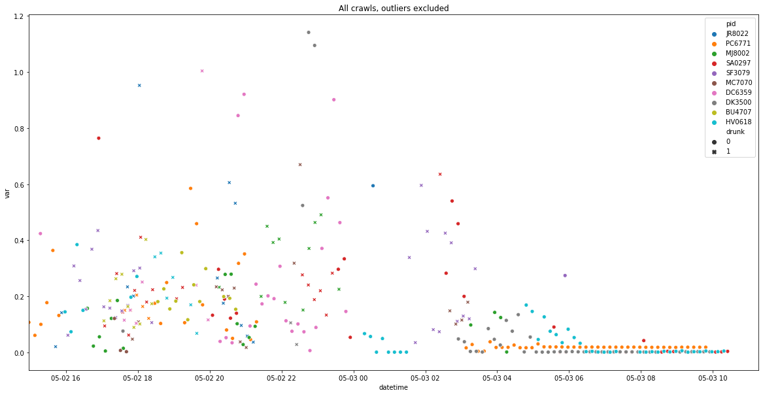
Exploratory Data Analysis
Observable difference between drunk and sober movement
Variance generally increases late at night, when participants are drinking most
Less variance towards end of event as participants sober up

Slide 5
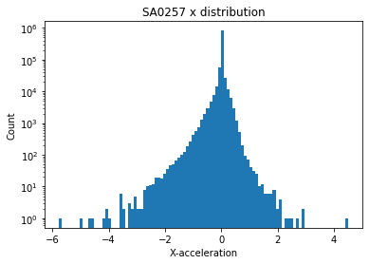
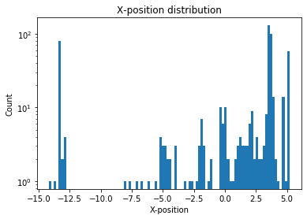
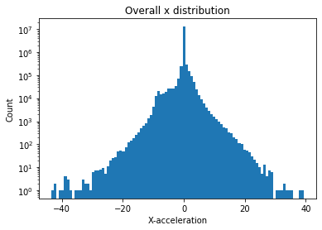
EDA cont’d
Acceleration data found to be normally distributed
To find original positions, acceleration data integrated twice: once for velocity, twice for position.
Positional data seemingly randomly distributed

Slide 6
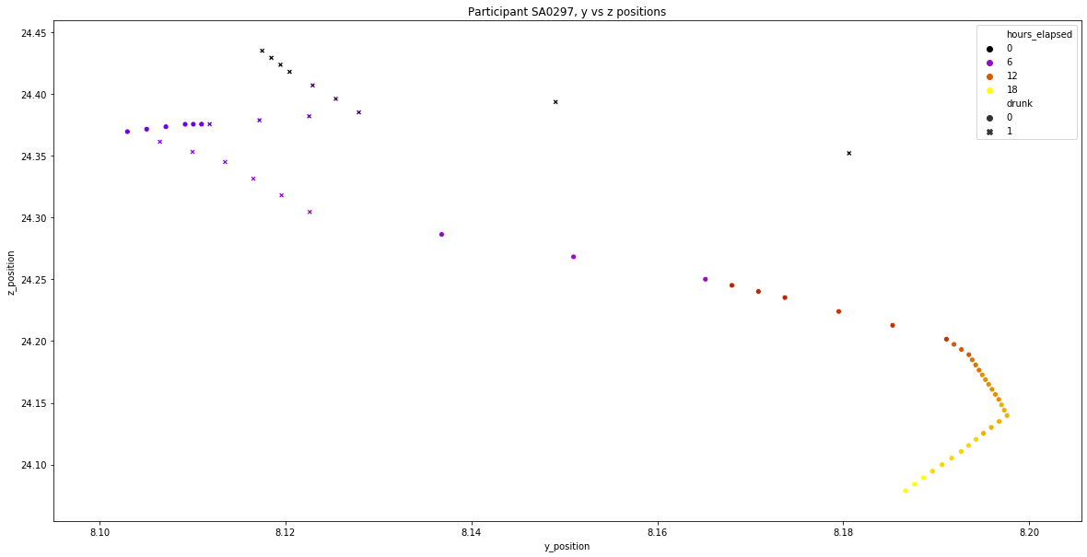
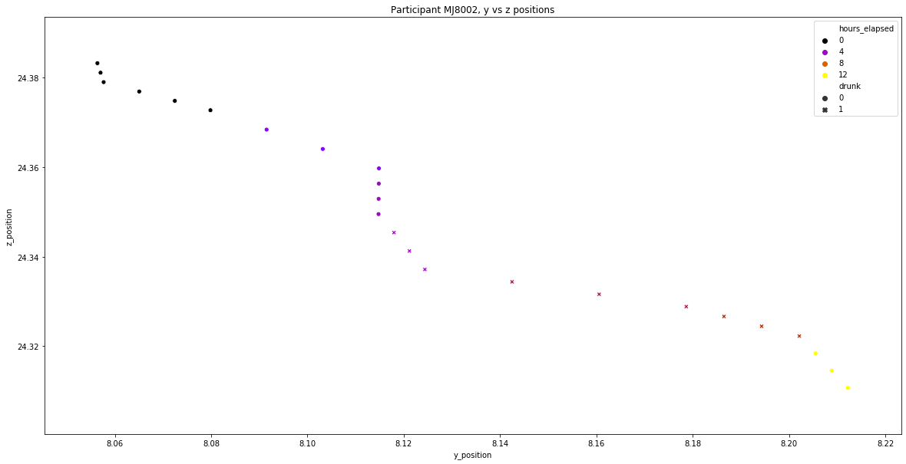
Visualizing the Crawl

Slide 7
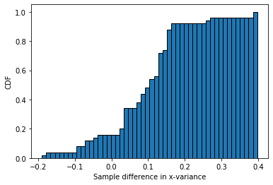
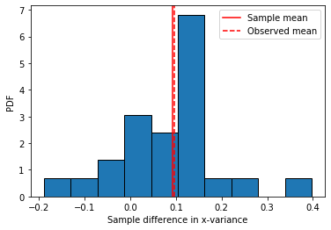
Inferential Statistics
Z-test used to calculate p-values
Null hypothesis: no difference between drunk and sober movement
Alternative hypothesis: statistically significant difference between groups
P-values:
X: 1.7e-7
Y: 0.0001
Z: 3.3e-7
Significance level: 0.05
Conclusion: null hypothesis is rejected; there is a statistically significant difference between drunk and sober movement

Slide 8
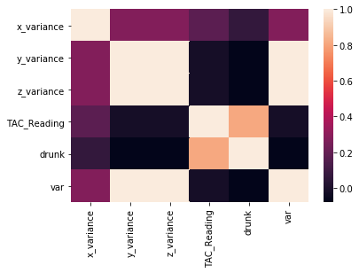
Machine Learning Models
Reminder: variances are features, target is “drunk” label
Standard Scaler or MinMax Scaler used for some models
Participant IDs converted from categorical strings to binary numericals (dummy variables) with one-hot encoding
TAC tested as feature, but considered “cheating” based on collinearity with “drunk” label
4 algorithms used: Logistic Regression, Support Vector Classifier, Random Forest, Gradient Boost

Slide 9
Improving and Evaluating
Data is a time series, therefore it requires stratified sampling; otherwise, collinearity with time means “future leakage” will contaminate model
Originally, naively split data into first 70% training, last 30% test
Realized mistake - had to split for each participant, not for the entire dataset at once
Proper split made models more stable and effective
Evaluation metric - F1
Class imbalance - only 30% drunk
Null accuracy - ~85%; hence, accuracy bad metric
F1 measures precision and recall
Want to avoid Type II errors - when someone is drunk but model predicts they’re sober (recall)
Adjusting probability threshold to account for class imbalance yielded questionable results

Slide 10
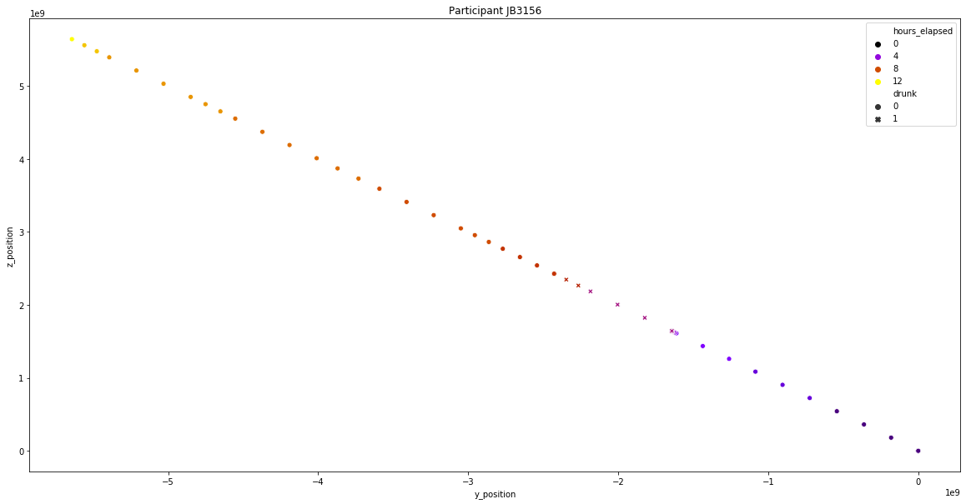
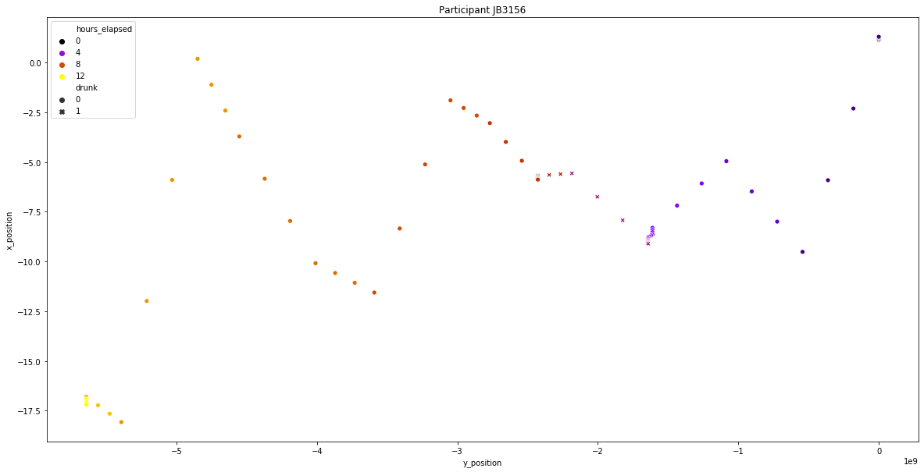
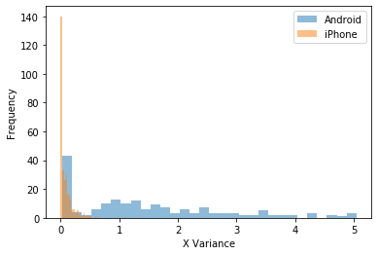
Phone Types
Reexamined data in terms of phone types of users
Two Android users, rest iPhone
Clear difference between two groups
Histograms look nothing alike
Average variance: iPhone = .08, Android = 1.4 (data not on same scale)
P-value: 3.3e-12 - null hypothesis rejected
User found to have bad data
Movement not possible in 3D space
Average variance with user excluded: sober = .27, drunk = .84 (in line with expectations)
Trained models with phone type and “crazy_user” label as features, also excluding bad user
Excluding bad user had largest positive impact

Slide 11
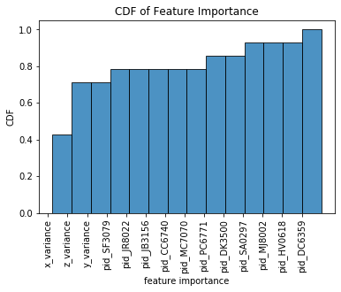
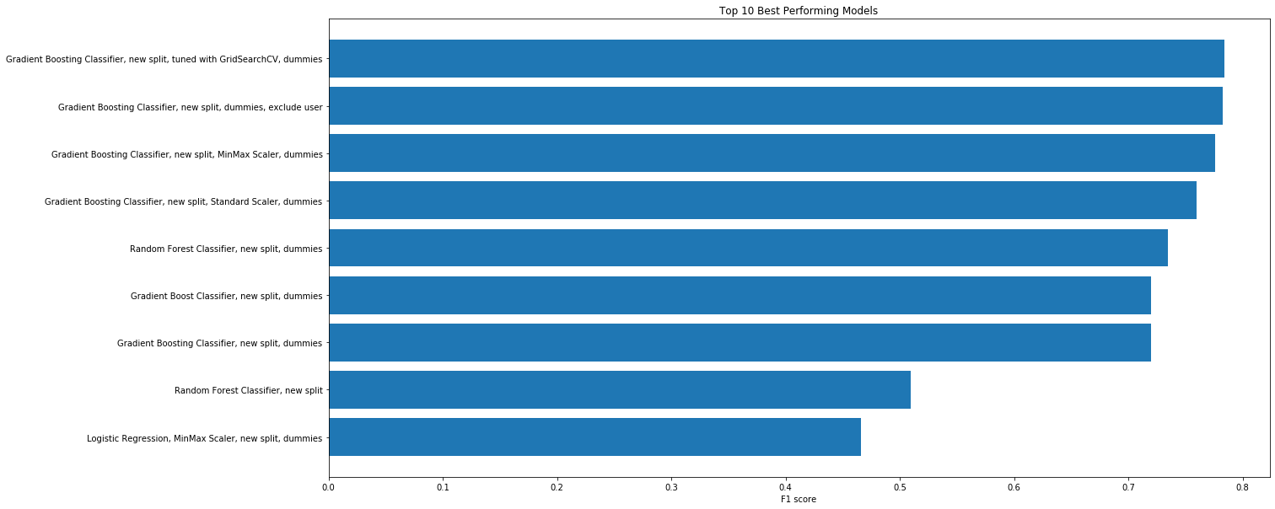
Conclusion
Best-performing model: tuned Gradient Boosting
Ensemble methods often perform best
Gradient Boost - uses bootstrap aggregating (bagging) and gradient descent to improve weak learners, focus on source of error
F1-score: .784 (max of 1.0), test accuracy: 93.3%
X-variance (vertical axis) found to be most important feature, despite having least variance
Participant Ids accounted for ~25% of model variance
ML model indeed able to classify drunkenness based on movement

Slide 12
Expansion
Potential to build heavy drinking warning application
Would need to improve recall further - Type II errors
Reprocess raw TAC readings, check if duplicate user has valid data
Change threshold and re-evaluate models
Attempt ensemble classifier of best models
Compare drunk/sober movement to data of other activities:
https://archive.ics.uci.edu/ml/datasets/WISDM+Smartphone+and+Smartwatch+Activity+and+Biometrics+Dataset+

